Slide 1
Sales Meeting Activities
10 team meeting activities to use with your sales people to get them motivated and to enhance their skills and abilities

Slide 2
Quick overview of this pack
Most sales meetings are boring…
They are usually just focused on performance and figures and if you’ve heard “loads bubbling” once you’ve heard it a thousand times!
The most effective sales meetings have a good balance of reviewing sales performance and also skills development.
This pack gives you 10 activities to run with your sales teams to help improve their skills. They have been created so they last between 10 to 20 minutes so they are short and punchy.
We’ve included what you need to do and any preparation needed beforehand.
Enjoy!

Slide 3
Protecting MTD Sales Training as well as you!
MTD own the copyright to these materials.
But we’re not a stuffy company with loads of hoops that you have to jump through to use them.
All we ask is that you do not pass these materials off as your own, sell, rent or sub-license the pack.
That said we don’t mind if you alter or amend the information as long as you keep the MTD Sales Training logo and link visible – that’s why we have created this in PPT for you.

Slide 4
Contents: 10 team meeting activities for sales
Communicating Your Competitive Advantage
How To Shake Up Stale Deals
How To Use Case Studies More Effectively
How To Handle Questions About Pricing
How To Handle Objections And Resistance
Managing And Planning Around Vulnerable Accounts
Reviewing Your Sales Activity & Numbers
Sales 101 – What Works & What Doesn’t?
Analysing Your Sales Cycle
Creating A Memorable Sales Experience

Slide 5
Your Competitive Advantage

Slide 6
Your Competitive Advantage - Overview
Because we are so close to what we sell we, at times, can take our benefits and competitive advantages for granted.
It’s as though we think that our prospects and clients should already know them. But guess what? They are not mind readers!
They will only learn what we tell them or the information that they come across.
This session gets your team to look at what your competitive advantages are and where and how they can weave them into the conversations you have with new and existing customers.

Slide 8
What You Need To Do…
# 1 - Split your team into small groups and ask them to brainstorm all of your competitive advantages. Include all of the features and benefits of what you sell, your company, skill sets – everything you can think of.
# 2 - Your job then is to go around each group whilst out the front using a whiteboard or flip chart and make one master list from the feedback of each group.
# 3 - Split your people into 3 groups and give each group a buyer type that they will focus on for the next part of this session…

Slide 9
Buyer Types
GROUP 1 – Prospective Customers
GROUP 2 – Existing Customers (Who have purchased in last 12 months)
GROUP 3 – Existing Dormant Customers (No purchased within last 12 months)

Slide 10
What You Need To Do…
For each group ask them the following in relation to the buyer types they are looking at:
How do you currently use your key competitive advantages with that group of people?
How could you use your key competitive advantages more effectively with that group of people?

Slide 11
Individual Action Planning…
Ask each member of your team the following questions…
What did you learn from this exercise?
What are you going to start doing?
What are you going to stop doing?
What are you going to do more of?
What are you going to do less of?

Slide 12
Shaking Up Stale Deals

Slide 13
Shaking Up Stale Deals - Overview
We’ve all been there – those deals that are stuck in the pipeline and don’t look like moving forward any time soon.
Nothing happens for a couple of weeks or months and these deals become stale.
This session will help your team to generate ideas to overcome the stagnation of their sales pipelines by ‘shaking up’ these stale deals.

Slide 14
What You Need To Do…
Preparation & Set Up
Ensure that your sales people come prepared with a couple of scenarios where an opportunity has become stale and is stuck in their pipeline for whatever reason. This is very important!

Slide 15
What You Need To Do…
# 1 In turn, get your team to give an example of one of their stale deals, including an explanation of what stage of the sale they are at and the actions they have already taken.
# 2 Brainstorm the reasons why they have become stale and why the prospect has placed the project on hold.
# 3 Get your sales people to pair up and delegate each pair a reason from the list. Now for each reason – get your pairs to generate three methods and strategies to shake up these stale deals. Give them 5-10 minutes to discuss and write down their ideas.
# 4 Bring the group back together and get them to discuss their methodologies for shaking up the stale deal and how they can implement these methods with their own stale deals.

Slide 16
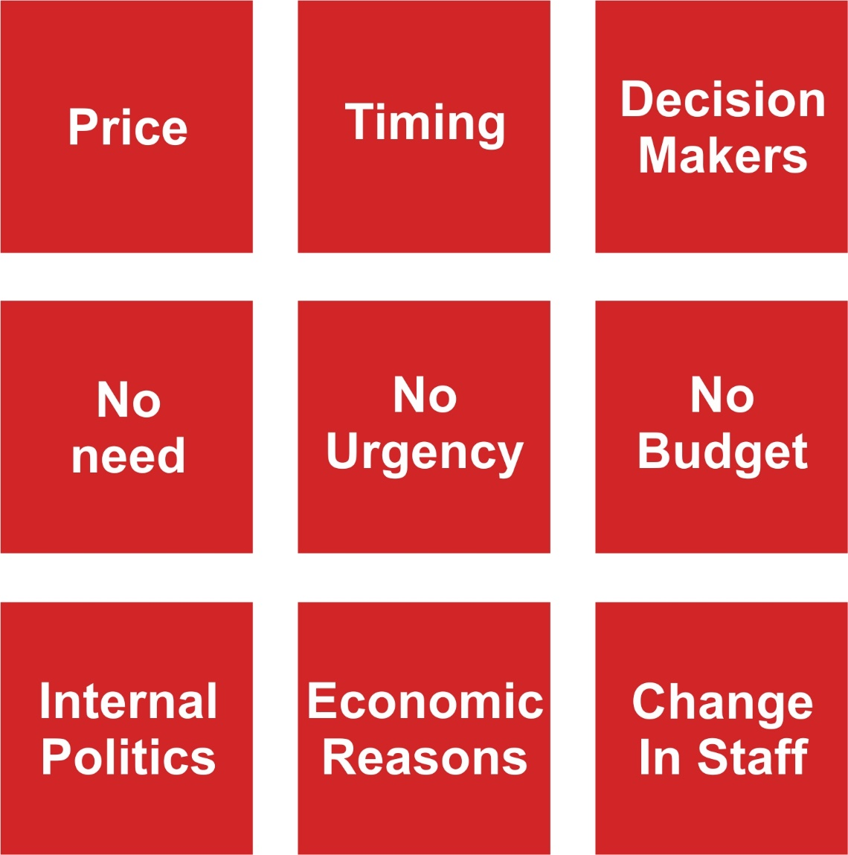
Potential Reasons For Stale Deals…

Slide 17
Individual Action Planning…
Ask each member of your team the following questions…
What did you learn from this exercise?
What are you going to start doing?
What are you going to stop doing?
What are you going to do more of?
What are you going to do less of?

Slide 18
Using Case Studies

Slide 19
Using Case Studies - Overview
Providing social proof is critical for building up trust and credibility with your prospects and clients.
They provide assurances that others had the same issues or situation and that they have benefited from your products and services.
But does your team use them? Are they using the same ones?
This session takes time out to review what you’re currently using and whether there are any gaps in the type of case studies you need going forward.

Slide 20
What You Need To Do…
# 1 As a group brainstorm all of the case studies that are at your disposal for use with prospects and clients, before, during and after the sale.
# 2 Take a poll as to whether everyone knows the case studies that are available. Make a note of who needs to know what and take that offline at the end of the session.
# 3 Categorise the list of case studies into the buyer types, objections, or instances where they would be most useful.
# 4 Is on the next slide…

Slide 21
What You Need To Do…
# 4 Brainstorm the objections that you receive regularly or the reasons why your prospects choose someone else and make sure you provide case studies to overcome each of them. Your case studies should follow a similar outline to:
The issues/challenges the client faced
What was important to them in deciding a solution
Why did they choose you?
How you helped them?
The results they achieved
Client comment if possible
Identify any gaps that you have in terms of the case studies you already have the type of case studies that you need and take action points to getting them created and distribute throughout the team in a follow session.

Slide 22
Creating Impactful Case Studies

Slide 23
Individual Action Planning…
Ask each member of your team the following questions…
What did you learn from this exercise?
What are you going to start doing?
What are you going to stop doing?
What are you going to do more of?
What are you going to do less of?

Slide 24
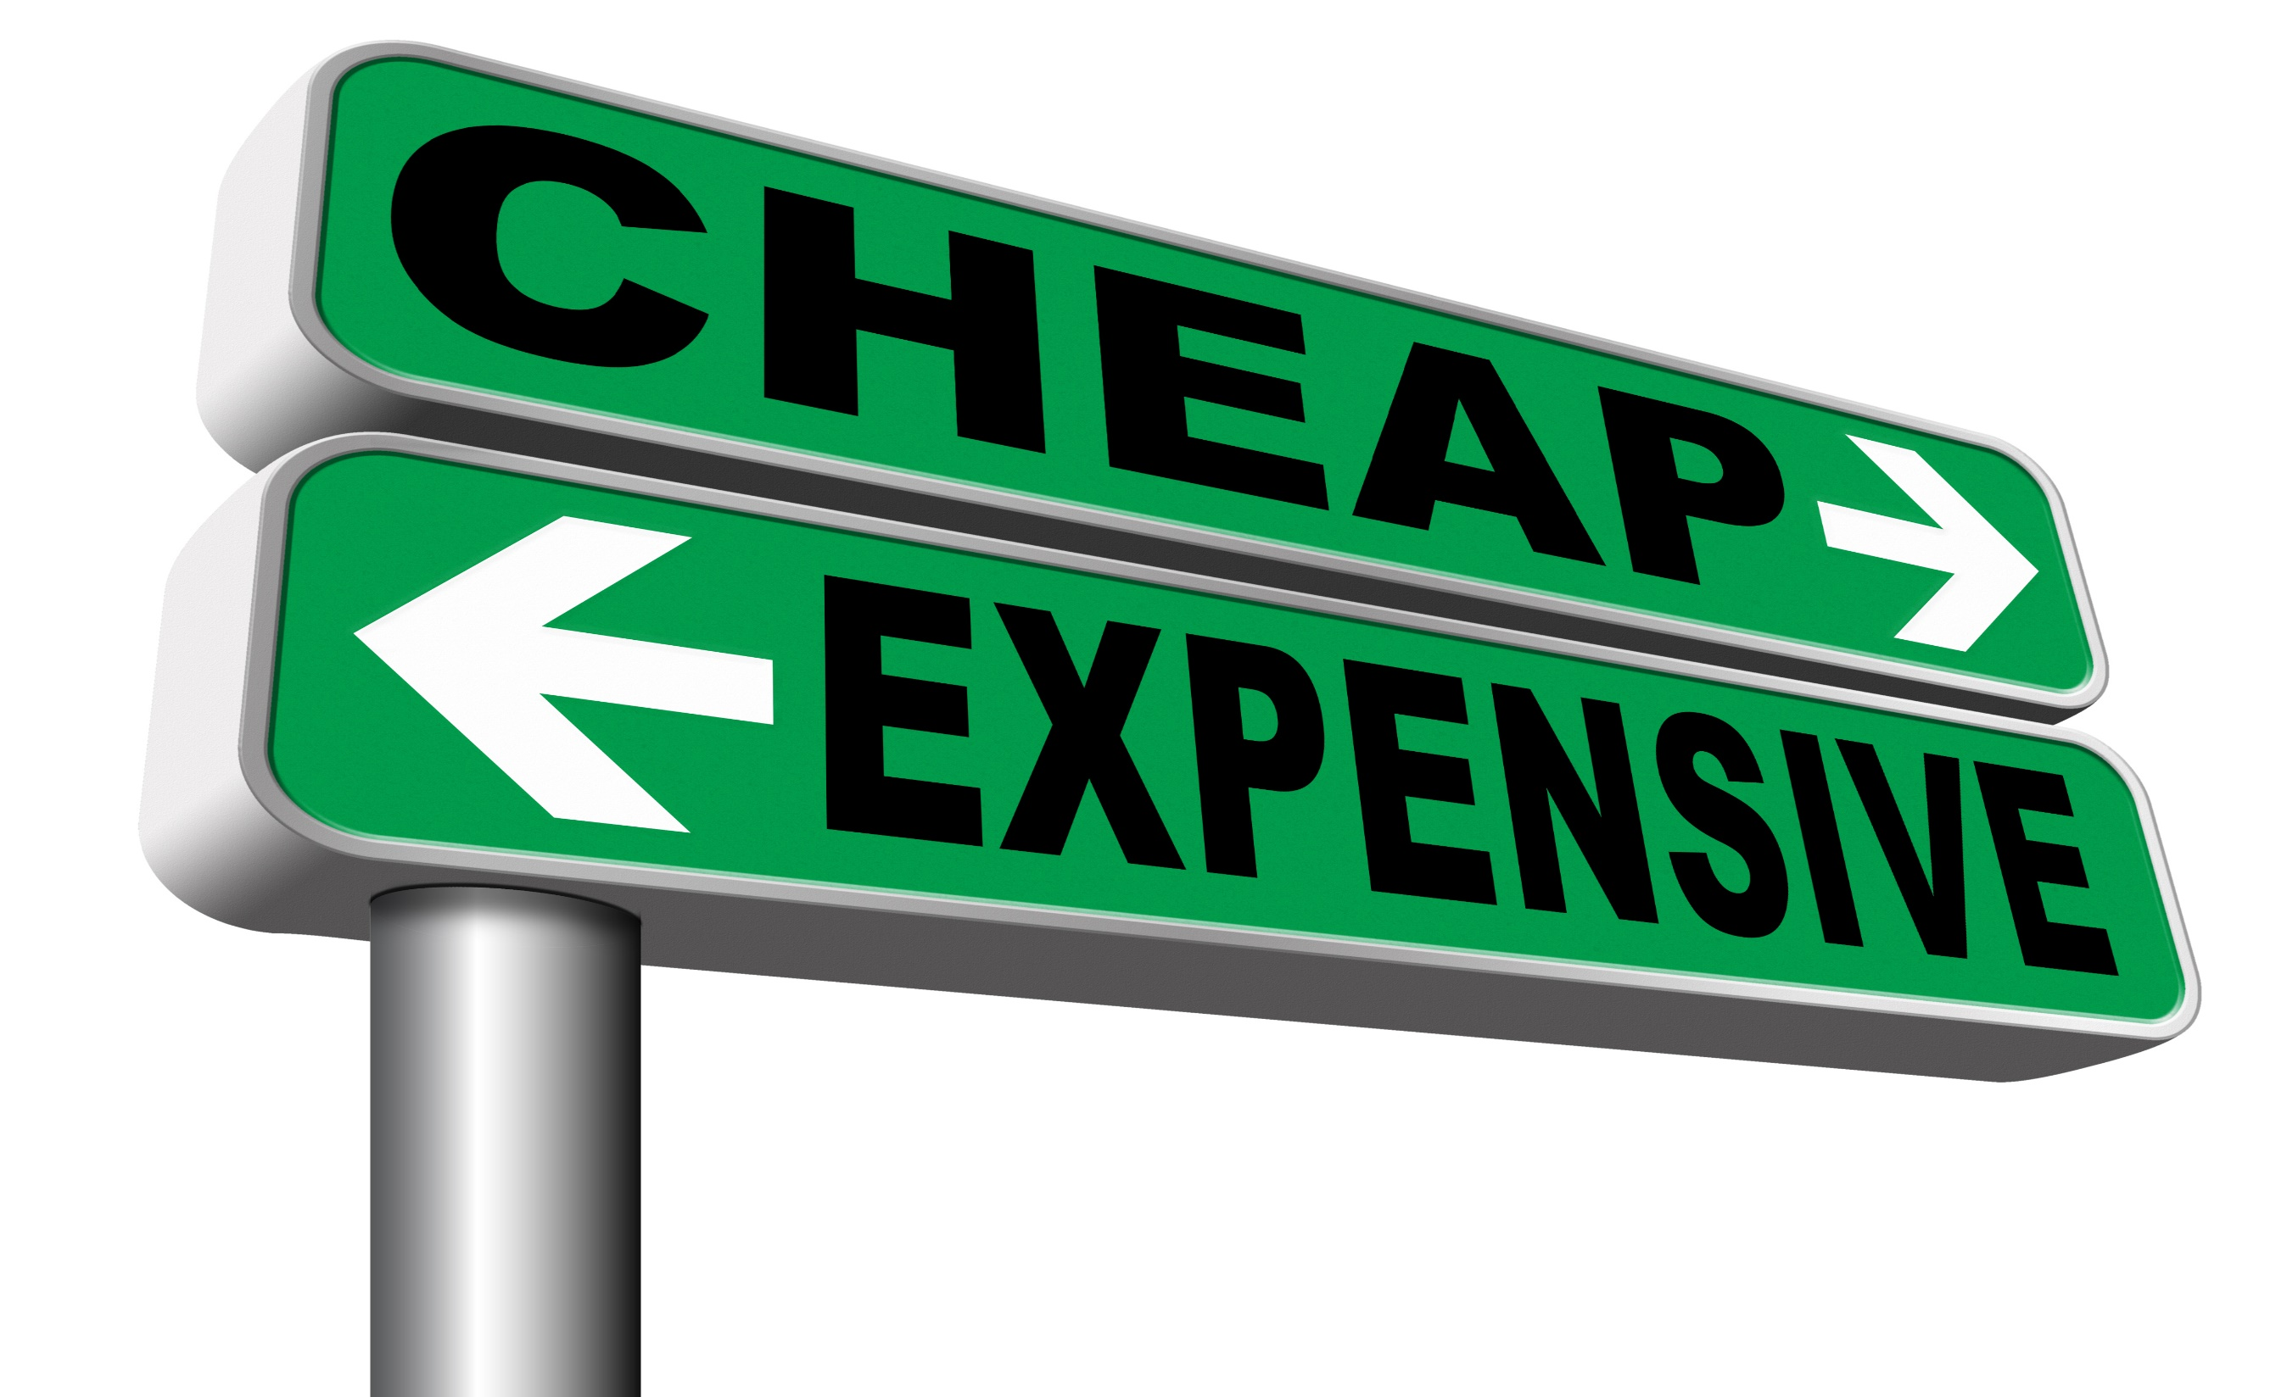
Handling Price Questions

Slide 25
Handling Price Questions - Overview
For most sales people, the “price question” is something they are asked on a daily basis.
How you address this question can sometimes be the difference between success and failure when it comes to gaining the business.
This session focuses on how to effectively deal with price enquiries and where your sales team may currently be going wrong.

Slide 26
What You Need To Do…
Preparation & Set Up
Before the sales meeting – instruct your sales team to call 5 external companies and ask them to make a price enquiry. They should write down for each company they call: -
What answers aroused your interest and were both informative and made you feel respected
Rate the companies 1-5 on how they dealt with the price enquiry and give reasons

Slide 27
What You Need To Do…
# 1 - As a team, have a group discussion on how you currently approach the “price question”. What is the current goal you would like to achieve when the prospect makes a price enquiry? (Perhaps to just qualify them, or to set an appointment etc)
# 2 - Ask your sales team to get out the work they did previously when calling the external companies. Let each member of the sales team reveal their findings, including:
How did the responses make you feel?
Why did you choose that company at number 1 and that company at number 5?

Slide 28
What You Need To Do…
# 3 - After hearing each sales person’s findings, list in two columns:
What specifically made the experiences good?
What specifically made the experiences bad?

Slide 29
Competitor Analysis
Company | Response | Rating

Slide 30
Individual Action Planning…
Ask each member of your team the following questions…
What did you learn from this exercise?
What are you going to start doing?
What are you going to stop doing?
What are you going to do more of?
What are you going to do less of?

Slide 31
Handling Objections

Slide 32
Handling Objections - Overview
There are many generic pieces of advice for sales people on handling objections, however they may struggle to apply this to their own, real life scenario.
This session will highlight the main objections that your particular business faces and will give your sales team the knowhow on how to overcome these objections.

Slide 33
What You Need To Do…
# 1 - Give each member of your group five minutes to write down as many objections that they have heard from prospects.
# 2 - Hold an open discussion with your group and gather the most common objections that your team faces when selling your product or service. Make a list of the ten most common objections.
# 3 - Brainstorm as a group for each objection:
Relevant and intelligent questions that will determine the root of the objection
Suitable solutions to the objection
How you can position yourself as a suitable provider

Slide 34
What You Need To Do…
# 4 - Now that you have identified the ten most common objections and how to deal with them, pair up your sales team and let them take it in turns to play the role of the customer with the objection and to play the role of the sales person.
Practice each different objection and how to respond to these and, ultimately, position yourself as the best provider. This can even go beyond the meeting, by saying an objection as you pass a colleague’s desk and them coming up with suitable solutions.
With increased practice, the interaction will come naturally when facing an objection from a customer.

Slide 35
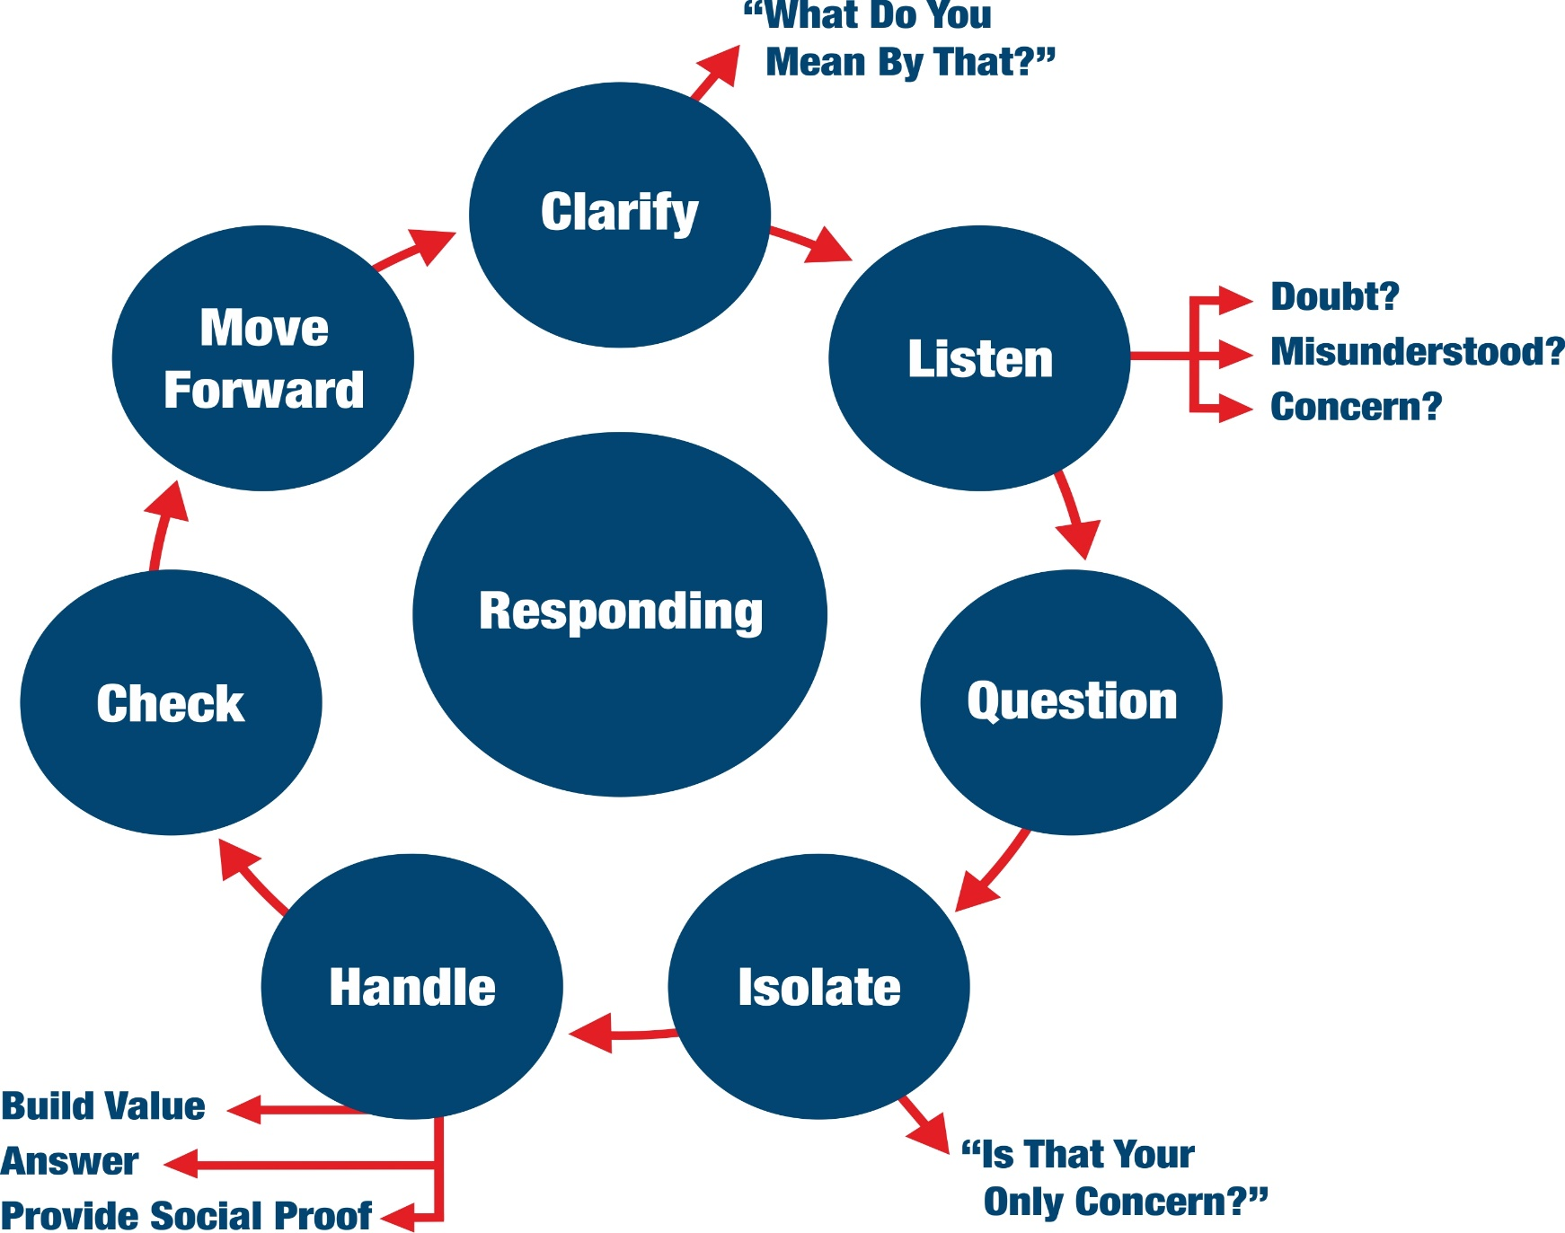
Objection Handling

Slide 36
Individual Action Planning…
Ask each member of your team the following questions…
What did you learn from this exercise?
What are you going to start doing?
What are you going to stop doing?
What are you going to do more of?
What are you going to do less of?

Slide 37
Handling Vulnerable Accounts

Slide 38
Handling Vulnerable Accounts - Overview
It’s important for sales people to know when the relationship with their accounts are vulnerable and are in jeopardy.
One of the greatest skills a salesperson can possess is the ability to know how to nip this in the bud early and stop any vulnerability with your account developing any further.
This session focusses on developing strategies to reduce the risk of relationships with your clients turning sour and will prevent you from losing the business.

Slide 39
What You Need To Do…
# 1 - As a group, brainstorm different ways your accounts can become vulnerable, this could include: - A change in point of contact - A change in leadership at a certain level of the client’s hierarchy - You’ve been moved further away from the decision maker by being passed to a middle manager or other member of staff
# 2 - Get each member of your sales team to share one of their accounts that are vulnerable. For each account include: - The name of the account which could be or is vulnerable - The reason why it is vulnerable and how it has or could develop

Slide 40
What You Need To Do…
# 3 - On a whiteboard or flipchart have 3 columns:
1. Account name
2. Reason why the account is vulnerable
3. Solution
# 4 - As a group – work through each individual account and make suggestions on how you can stop the vulnerability from progressing further. By covering many different scenarios, this will provide your sales team with a toolbox of ways to deal with vulnerable accounts.

Slide 41
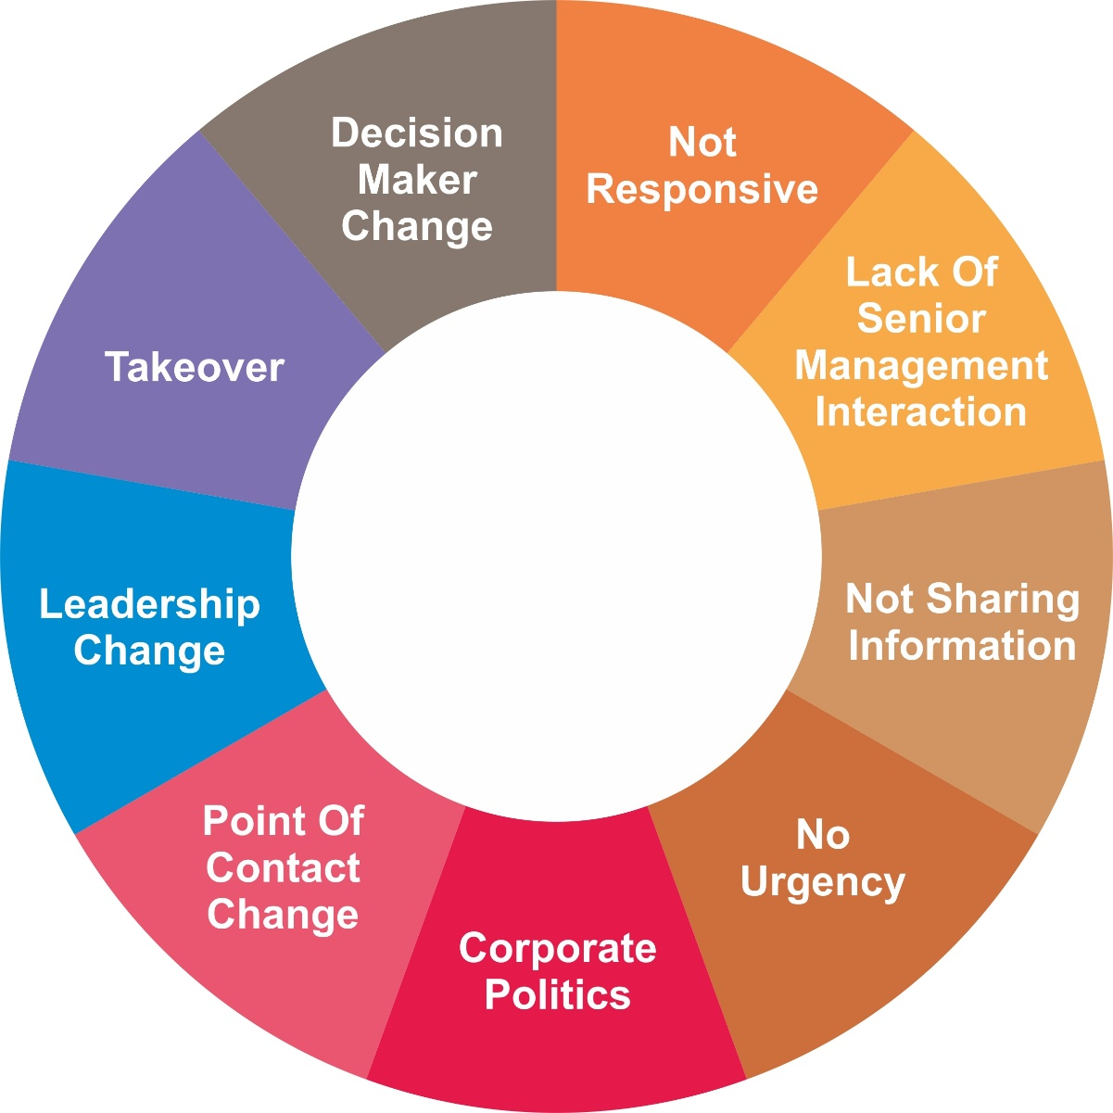
Vulnerable Accounts - Examples…

Slide 42
Individual Action Planning…
Ask each member of your team the following questions…
What did you learn from this exercise?
What are you going to start doing?
What are you going to stop doing?
What are you going to do more of?
What are you going to do less of?

Slide 43
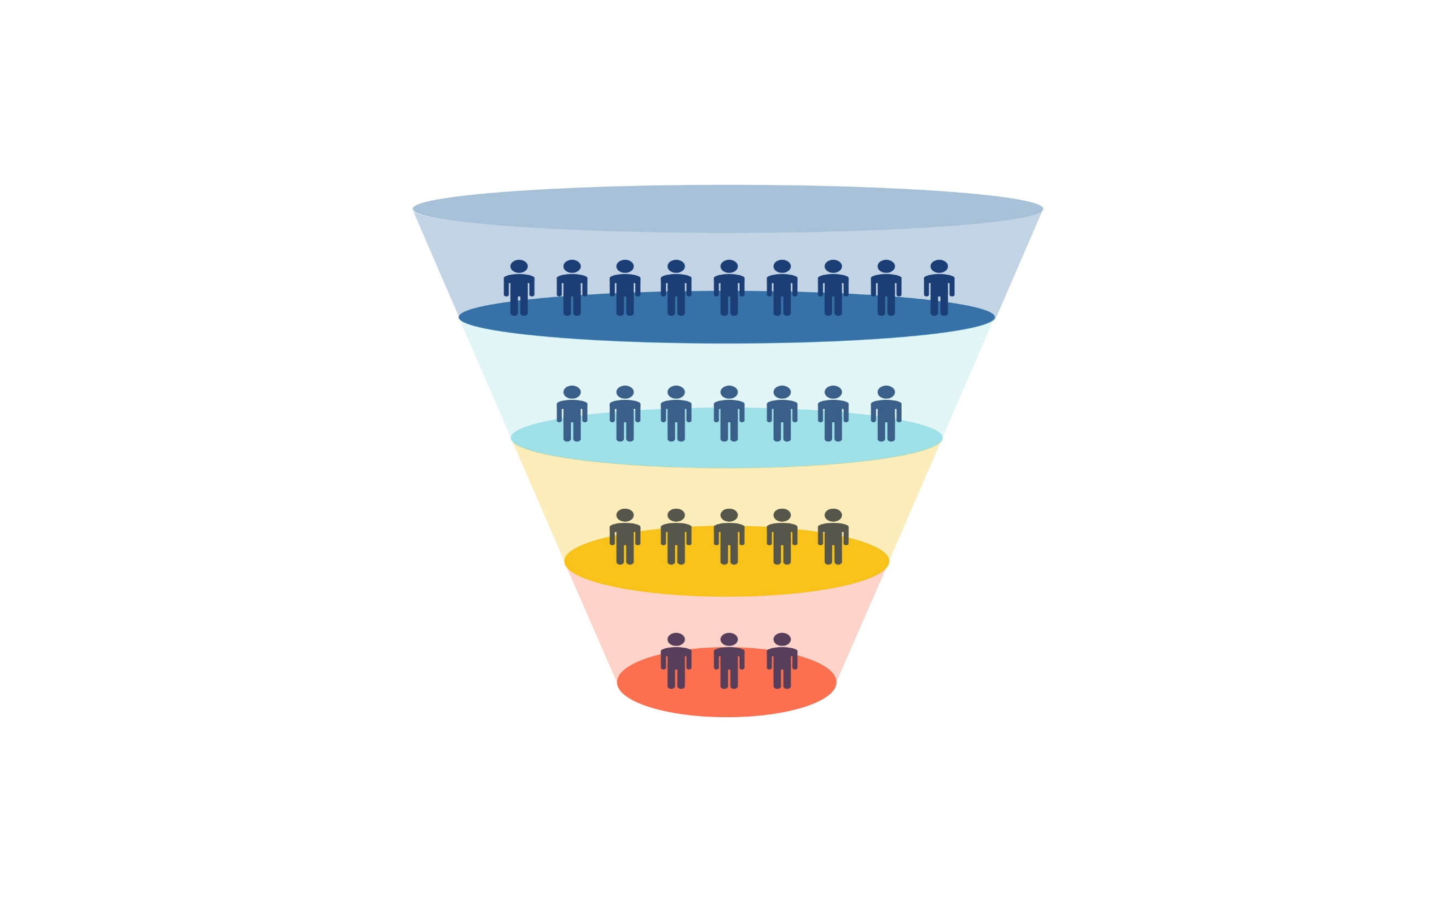
Reviewing Your Sales Activity

Slide 44
Reviewing Your Sales Activity - Overview
We all have targets to hit and in order to achieve them we need to have a well thought out plan of attack.
But is the plan a little hit or miss? Or is it based upon carefully thought out activity planning in order to achieve your objectives.
This session looks at breaking down your targets into activity based chunks so your team know exactly what they must do in order to achieve and exceed their targets.

Slide 45
What You Need To Do…
Preparation & Set Up
Mention the information on the previous slide in your introduction and that the purpose of this session is for us all to review our currently activity planning and what we’re focusing our time on.

Slide 46
What You Need To Do…
# 1 - Ask each team member to write down their sales target. This can be yearly or the upcoming period.
# 2 - Next, ask them to write down the following, and they must be based on actuals not guess work! (If you sales process is different then use measurements and stages that are right for you)
How many prospect meetings/interactions does it take to close 1 sale?
What is your average sale amount?
How many telephone calls do you need to make to have a quality conversation with a decision maker?
How many quality conversations with decision makers do you need to set up 1 face to face appointment?

Slide 47
What You Need To Do…
# 3 - Write down the sales activity that you are doing on a daily and weekly basis to hit your targets?
# 4 - Review your answers to task 2 and task 3. Do the maths and answer:
“Based upon your answers to task 2 (i.e. your current performance) are you doing enough activity and the right activity that you’ve listed in task 3?”
# 5 - What activity levels do you need to be doing to hit your target? What’s the difference between the current reality and what you need to be doing?

Slide 48
What You Need To Do…
# 6 - List anything that is getting in your way of carrying out the activity levels that you’ve described from task 5. What can you do about it as individuals? As a group? How can your manager support you?

Slide 49
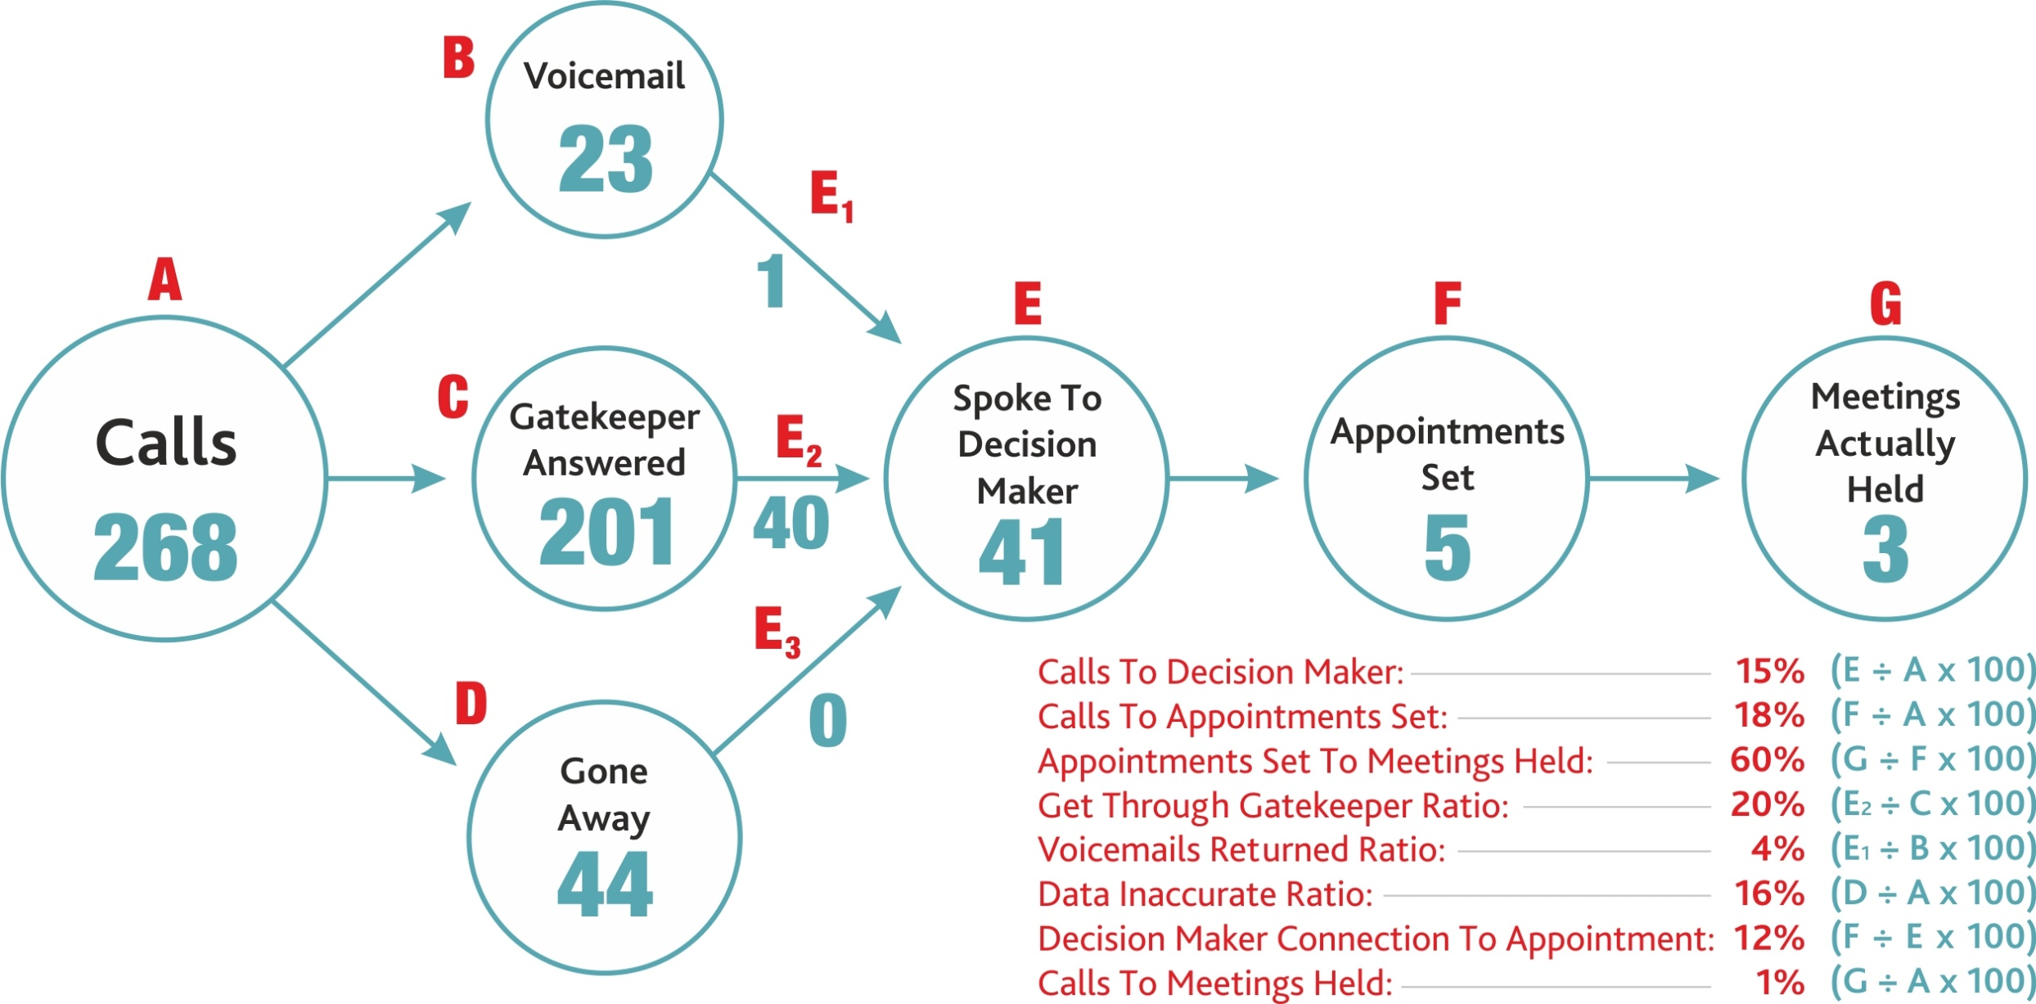
Understand Your Numbers

Slide 50
Individual Action Planning…
Ask each member of your team the following questions…
What did you learn from this exercise?
What are you going to start doing?
What are you going to stop doing?
What are you going to do more of?
What are you going to do less of?

Slide 52
Sales Room 101 - Overview
For many sales people, they will stick religiously to their sales processes and practices out of routine, whether or not they are working for them.
They will persist in the same daily sales activities instead of exploring new ideas.
This session focusses on what selling activities work for your business and sales people, and the practices that need to be put in ‘Sales Room 101’.

Slide 53
What You Need To Do…
# 1 - Brainstorm selling activities that are producing results for your business. Scrutinise the following:
How you generate leads
Making the initial contact with the prospect
Ways of creating proposals and quotes
Ways of moving the sale forward and closing the sale
(put down others here)

Slide 54
What You Need To Do…
# 2 - Draw a door with ‘Sales Room 101’ on your whiteboard and flipchart.
Get each member of your sales team to put one of their selling activities into Room 101.
List each one underneath this door and this will develop a list of ‘worst practices’.
If any team member is caught doing these practices, enforce a fun forfeit, such as them buying the cakes for a Friday afternoon.

Slide 55
What You Need To Do…
# 3 - From task 1, get each team member to pledge something from the list that they will start doing, and for them to give an example of how they can implement this with one of their prospects.

Slide 56
Individual Action Planning…
Ask each member of your team the following questions…
What did you learn from this exercise?
What are you going to start doing?
What are you going to stop doing?
What are you going to do more of?
What are you going to do less of?

Slide 57
Analysing The
Sales Cycle

Slide 58
Analysing The Sales Cycle - Overview
They say that change is the only constant – and that is no different in the world of sales and business.
As the business world changes, so will the way that your deals look and this will require a change in your sales cycle.
This session focuses on examining your current sales cycle and whether it requires any changes so that your sales team can recognise good opportunities, better understand deals in their pipeline and produce a new sales cycle if needed.

Slide 59
What You Need To Do…
# 1 - Each member of the sales team shares with the group a quick summary of a deal that they have closed recently – from start to finish.
Get your sales team to write notes for each summary so they can refer back to them later.
# 2 - Now in a group, discuss each deal and dissect them – use the following table with some suggested criteria over the page:

Slide 60
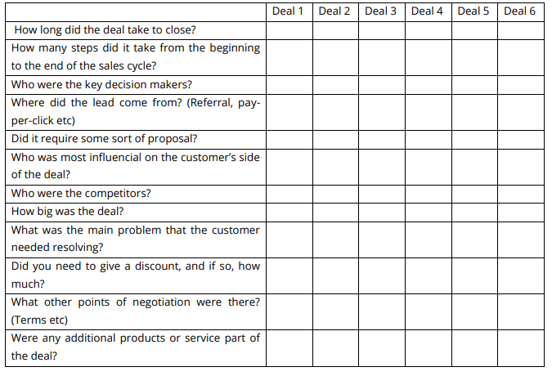
Deal Evaluator…

Slide 61
What You Need To Do…
# 3 - After coming up with the table and any criteria that you feel would be necessary, list the following
What are the similarities between deals? Is there any common patterns emerging?
Was there any features of these deals that weren’t appearing two or three years ago?
# 4 - Based on the above discussions – you will now be able to identify whether a change to your sales cycle will be needed. Any improvements to the cycle can now be applied.

Slide 62
Individual Action Planning…
Ask each member of your team the following questions…
What did you learn from this exercise?
What are you going to start doing?
What are you going to stop doing?
What are you going to do more of?
What are you going to do less of?

Slide 64
Creating A Great Experience - Overview
Everybody at some point in their lives has been a customer.
And more likely than not – we have been sold to in a way that has irritated or angered us at some point.
This session focuses on how your business can create a customer friendly experience by focusing on what the customer may find irritating and what turns them off from buying.

Slide 65
What You Need To Do…
# 1 - Discuss instances where your sales team have been irritated when being sold to or during the sales process when they were the customer.
For example:
When the sales person continues with their cold calling script despite the prospect not being even remotely interested
The sales person over promises and then, once the prospect agrees to do business, the sales person under-delivers.

Slide 66
What You Need To Do…
# 2 - For each scenario, discuss:
What the irritation was
The desired outcome of the salesperson
How they could make it a more customer friendly experience
# 3 - After that, discuss your current sales process and brainstorm ways to make it more customer friendly.
Step into the shoes of the prospect – is there any point where your current process may irritate them?
From this discussion and the discussion in Task One – adapt your sales processes and make them more customer friendly.

Slide 67
Individual Action Planning…
Ask each member of your team the following questions…
What did you learn from this exercise?
What are you going to start doing?
What are you going to stop doing?
What are you going to do more of?
What are you going to do less of?

